Slide 1
How to Complete a Non-unit Performance Evaluation
in the Oracle HCM Cloud

Slide 2
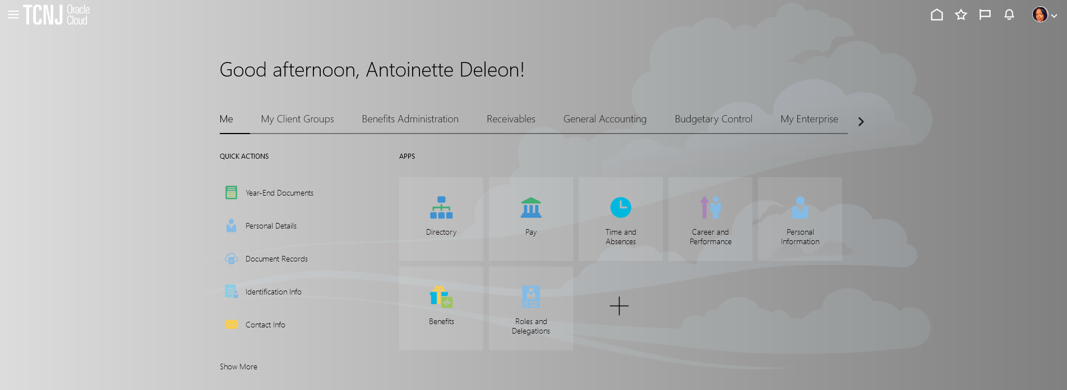
To begin the evaluation process, the individual whose performance is being assessed completes a self evaluation.
Log in with your username and password.
Confirm that the ME tab is selected.
Click the Career and Performance title.

Slide 3
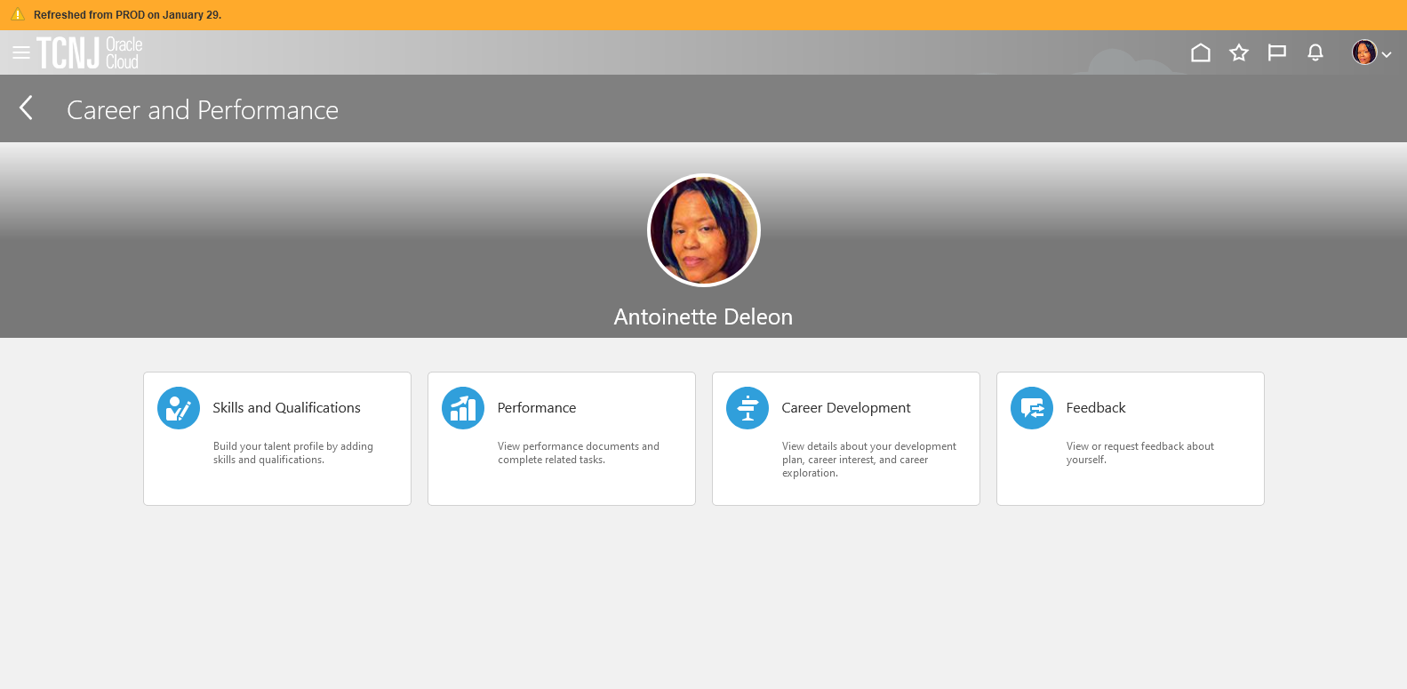
Click the Performance tile.

Slide 4
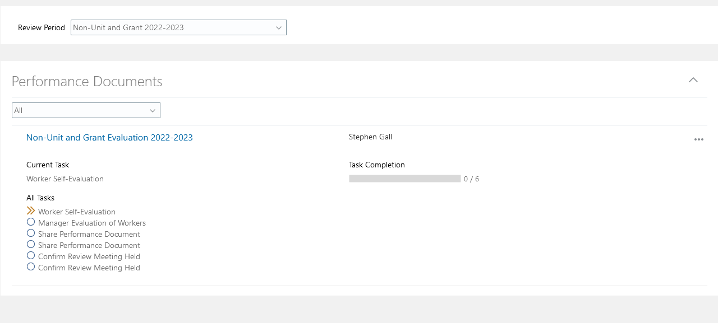
Confirm that Non-Unit and Grant 2022-2023 appears as the Review Period and click on the link for the Non-Unit and Grant Evaluation 2022-2023.

Slide 5
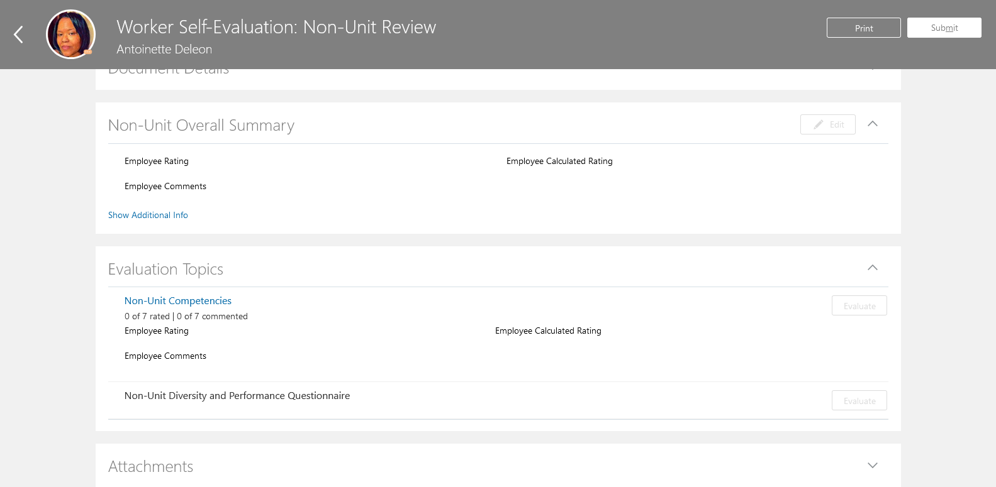
1. Click the Evaluate box next to Non-Unit Competencies.

Slide 6
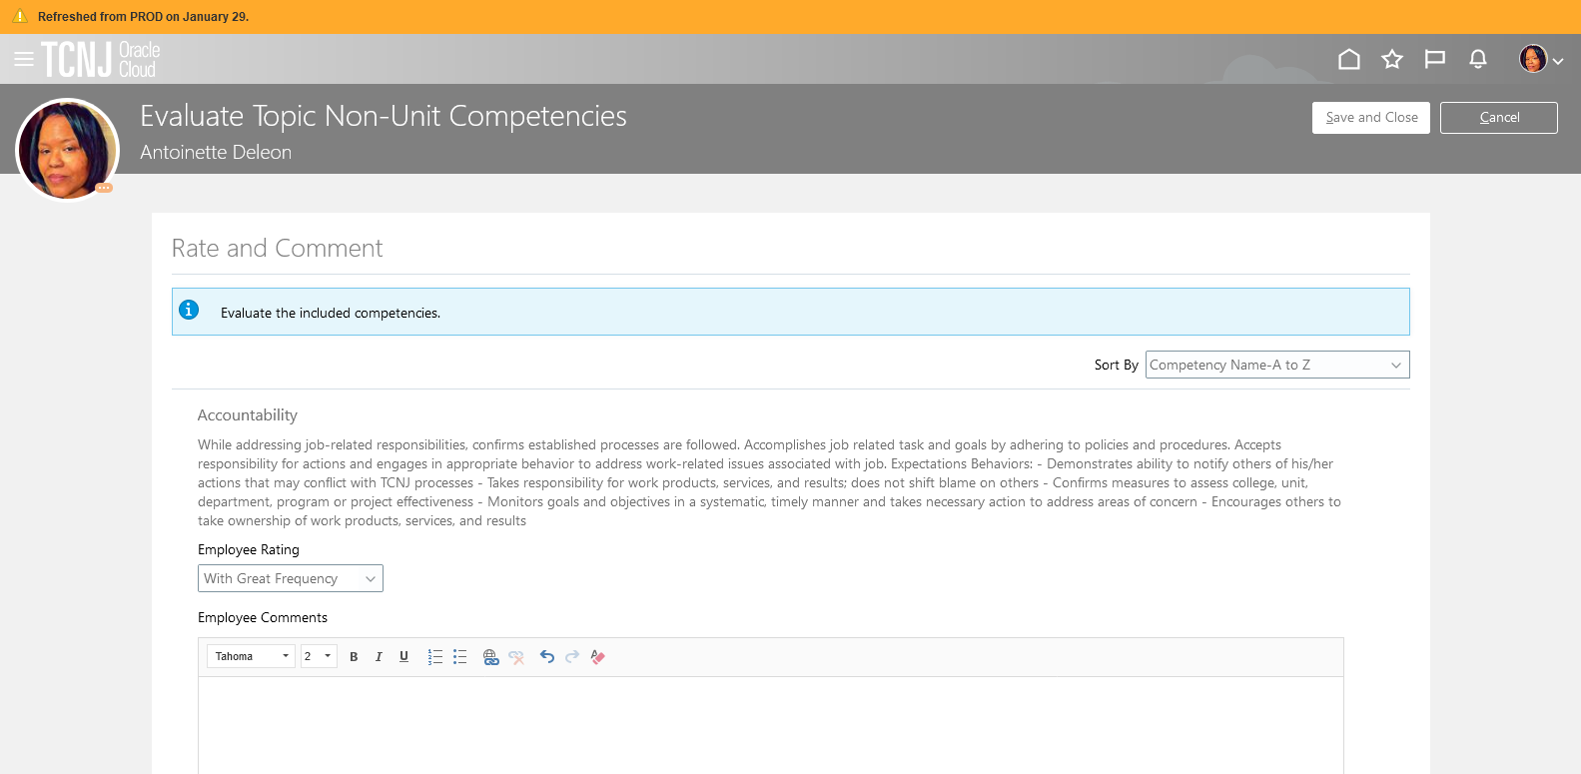
After rating each competency, you will click the Save and Close button and the form will update with an overall rating and performance score.

Slide 7
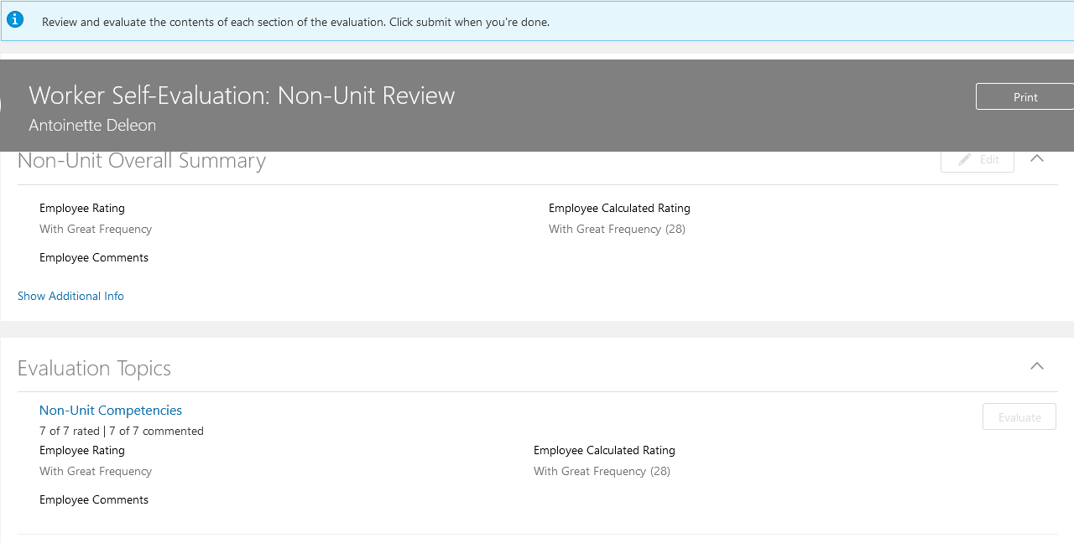
Notice that an Employee Rating is calculated on the basis of the competency evaluation.

Slide 8
Click the Non-Unit Diversity and Performance Questionnaire Evaluate button.

Slide 9
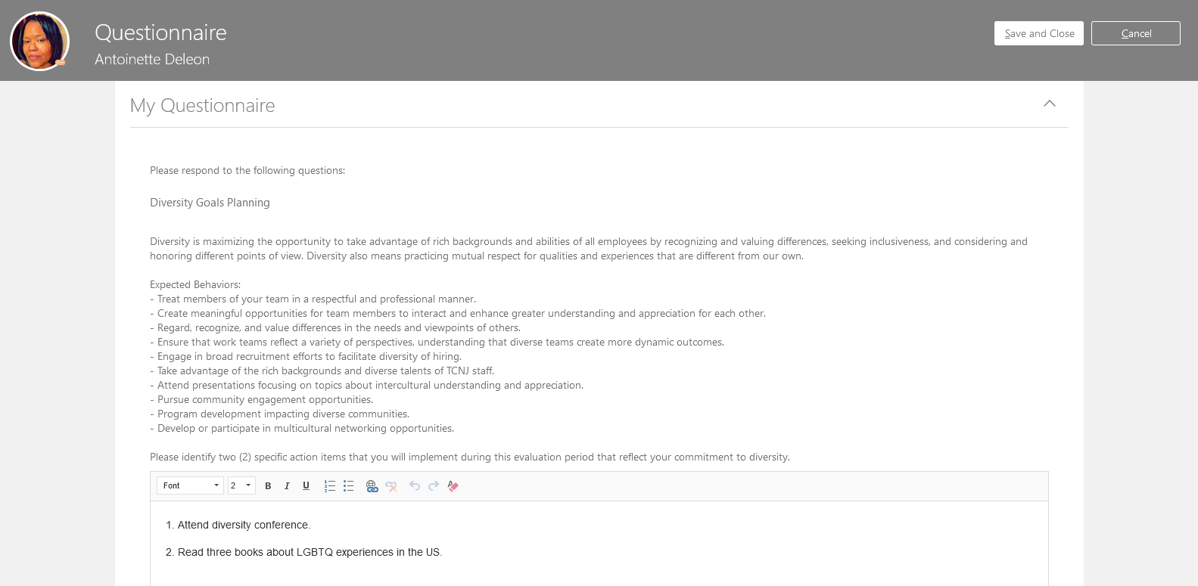
Enter the outcomes for the 2022-2023 performance year and the goals for the FY24 performance year. There are four questions in total. When you are complete with all entries, press Save and Close

Slide 10
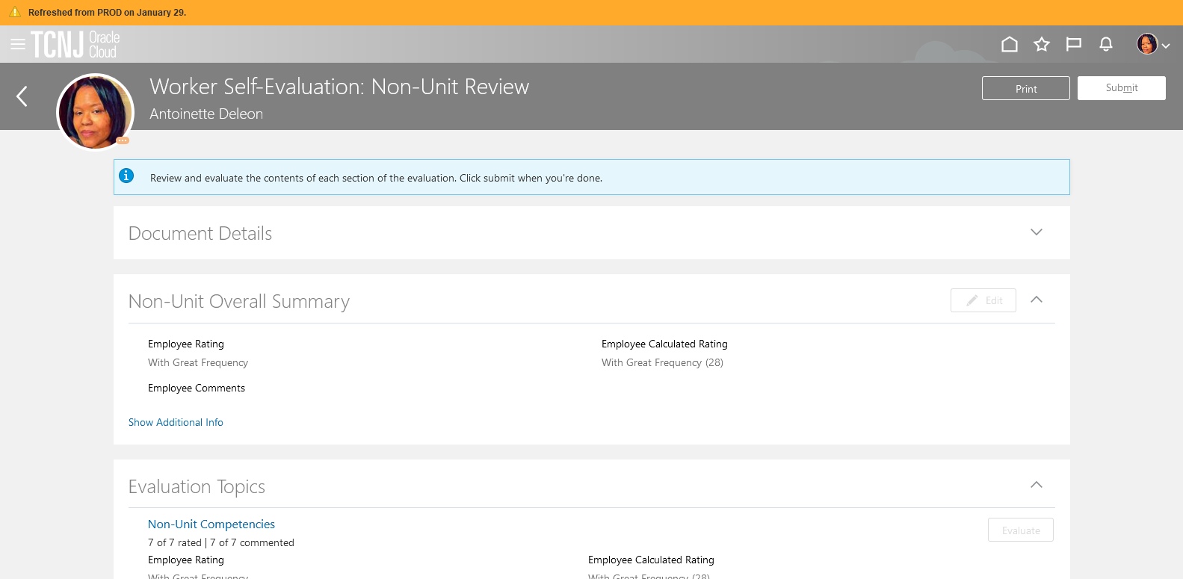
Click Edit to enter the Non-Unit Overall Summary.

Slide 11
On this page, enter overall comments about your performance during the period. When complete, press the Save button.

Slide 12
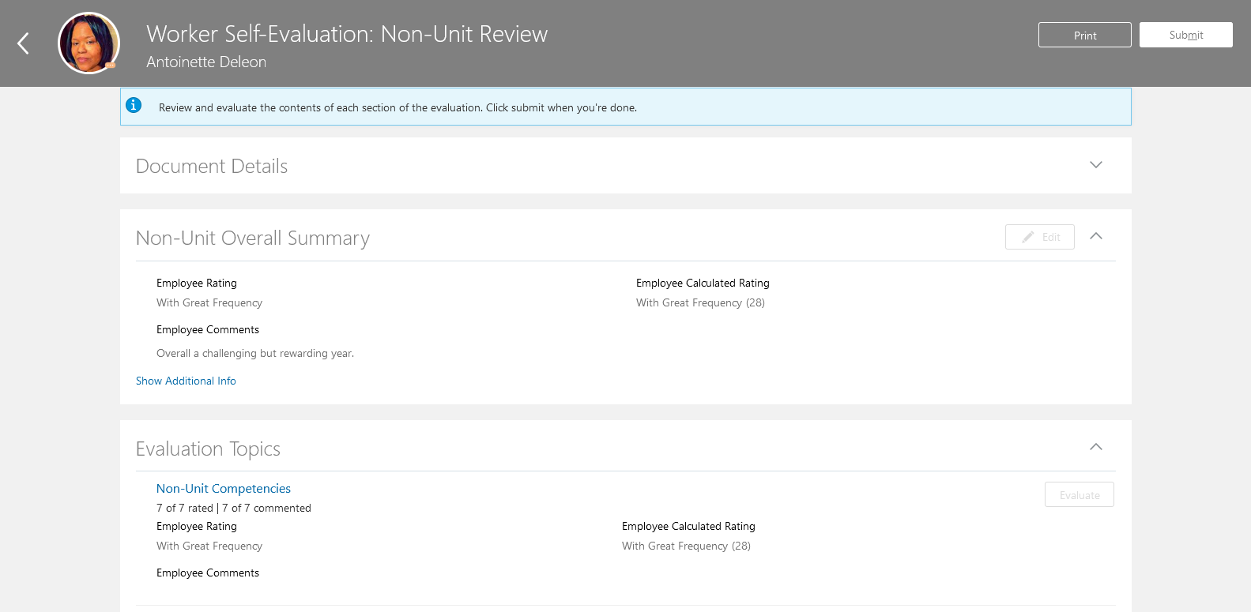
Employee entry is now complete. Press the Submit button to begin the manager evaluation.

Slide 13
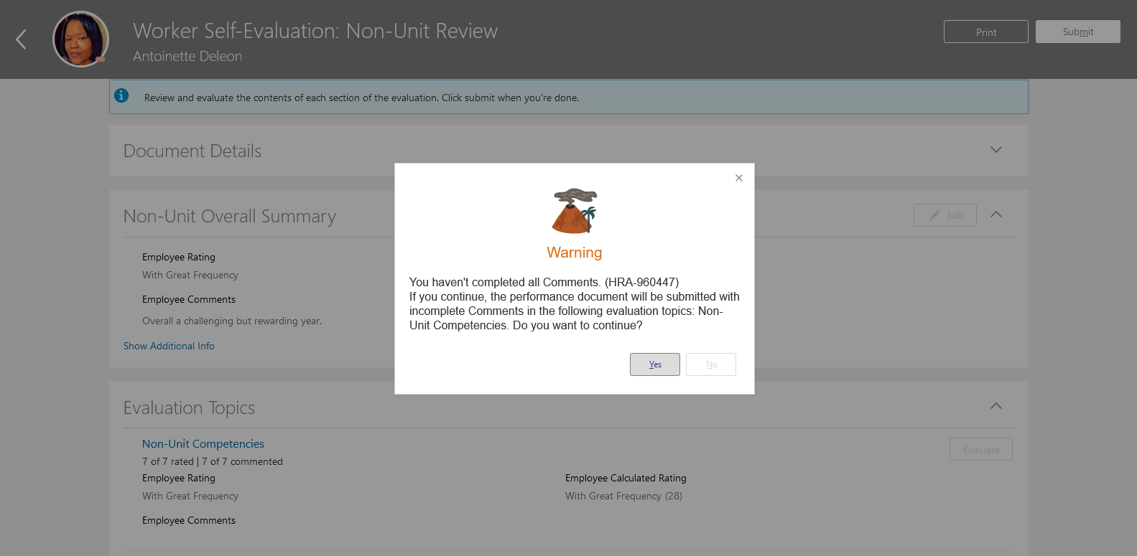
If you have not completed entries for all sections, you may receive a warning message as below. Review the details of the message, and if you would like to make updates, press the No button on the popup and update the document. If you with to not make further entries, press the Yes button.

Slide 14
You have now submitted the document up to your manager for approval. This is confirmed by looking at the green circle next to the Manager Evaluation of Worker task. Tasks with a check mark are complete, whereas those with a orange chevron are in process.

Slide 15
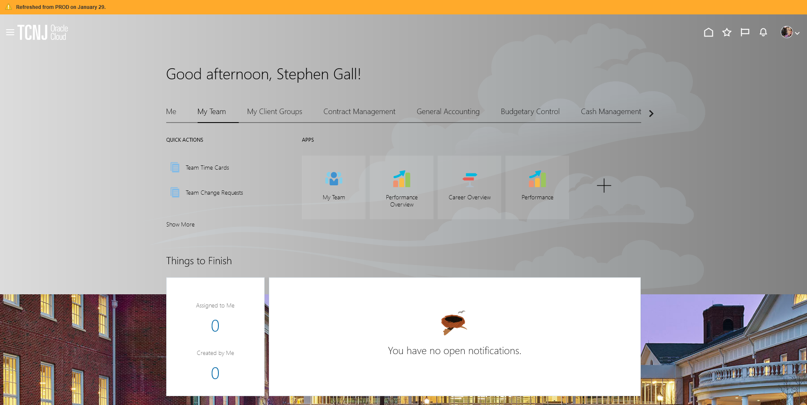
The employee’s self evaluation has been forwarded to the manager. The manager will view the
employee’s self assessment and will complete the evaluation.
Log in with your username and password
Confirm that the My Team icon is underscored
Click the Performance title.

Slide 16
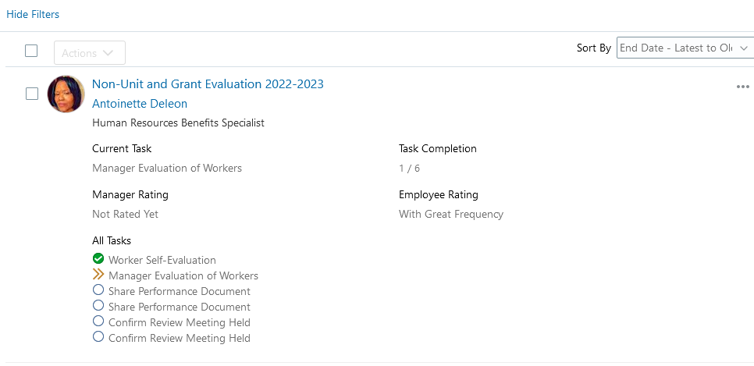
Confirm that Non-Unit and Grant 2022-2023 appears in the dropdown box. All employees in this cycle will appear. Workers ready for the manager to review appear with a horizontal arrow in the green box next to the Manager Evaluation of Workers task.

Slide 17
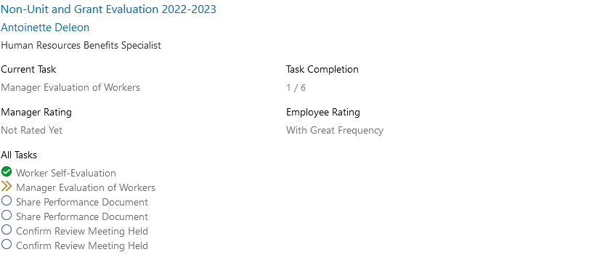
Click the Non-Unit and Grant Evaluation 2022-2023 link.

Slide 18
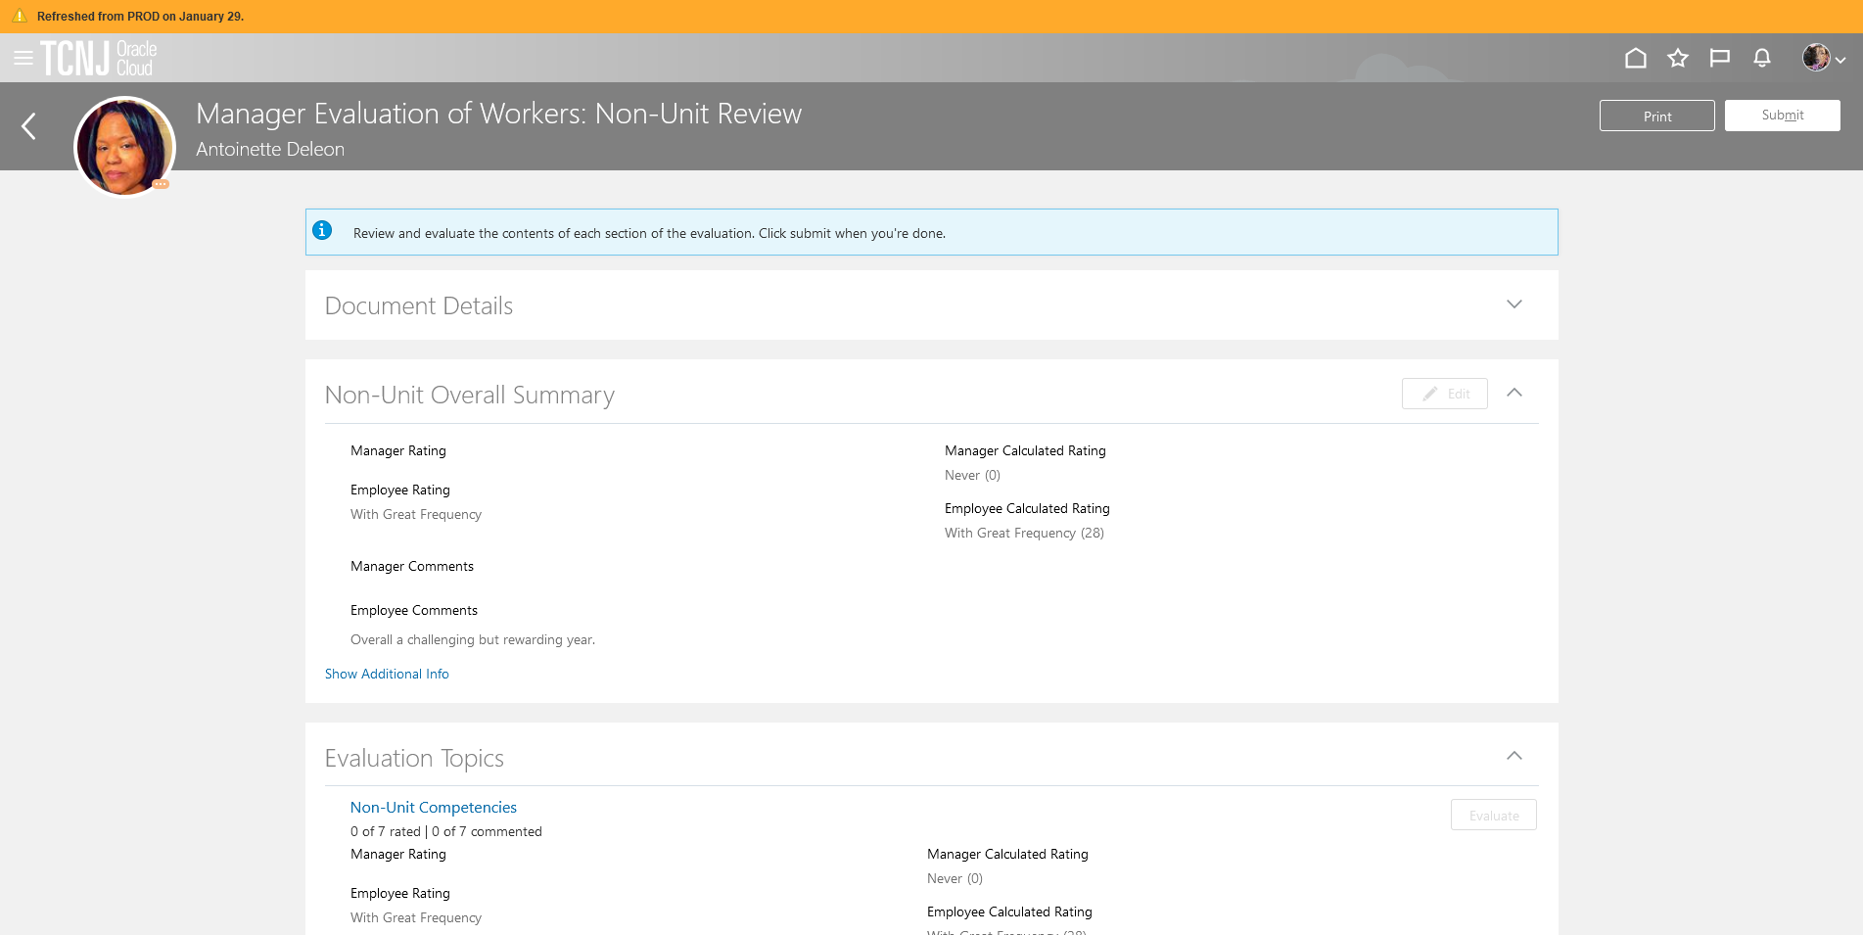
The manager will Evaluate the Non-Unit Competencies.

Slide 19
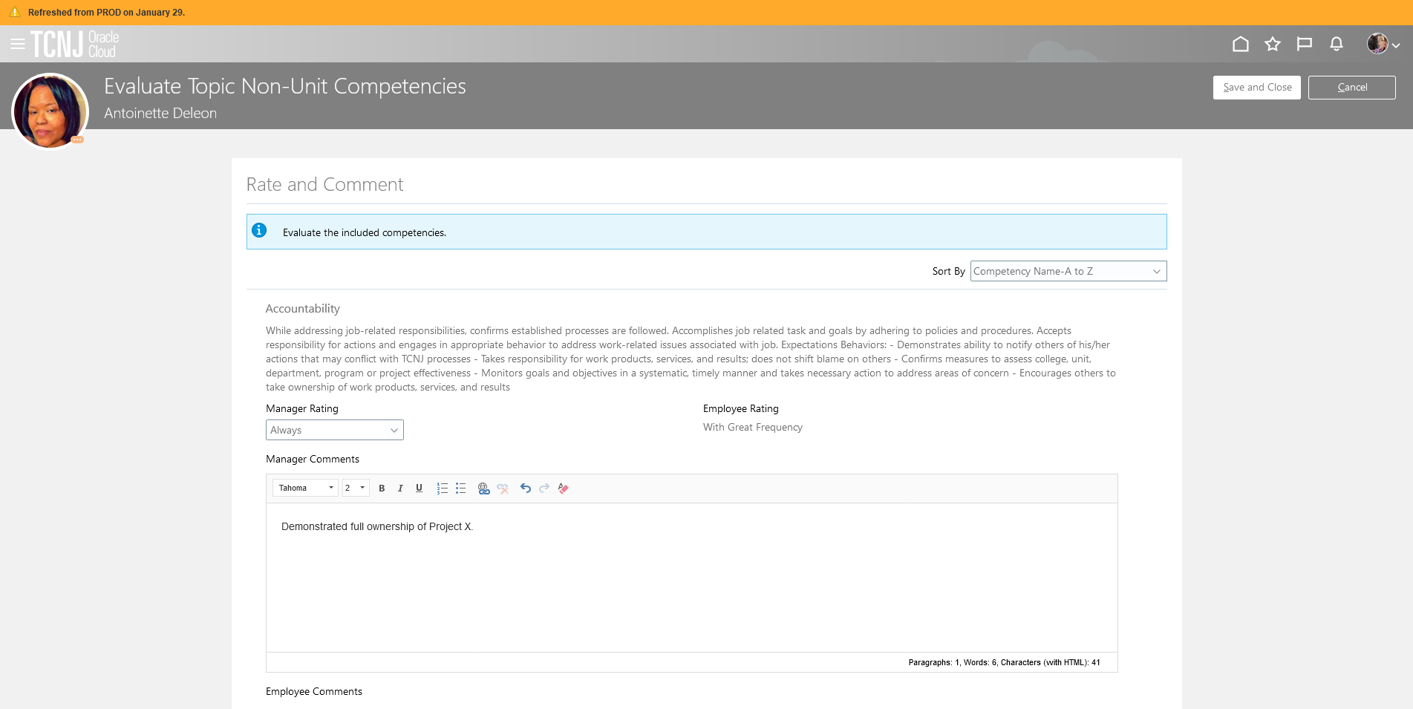
Once all competencies are evaluated, click Save and Close.

Slide 20
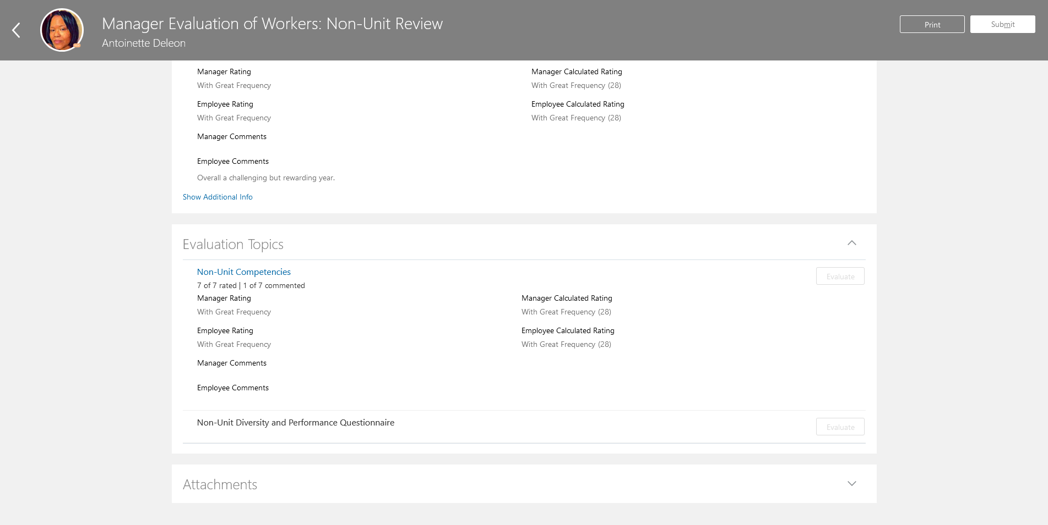
Evaluate the Non-Unit and Performance Questionnaire.

Slide 21
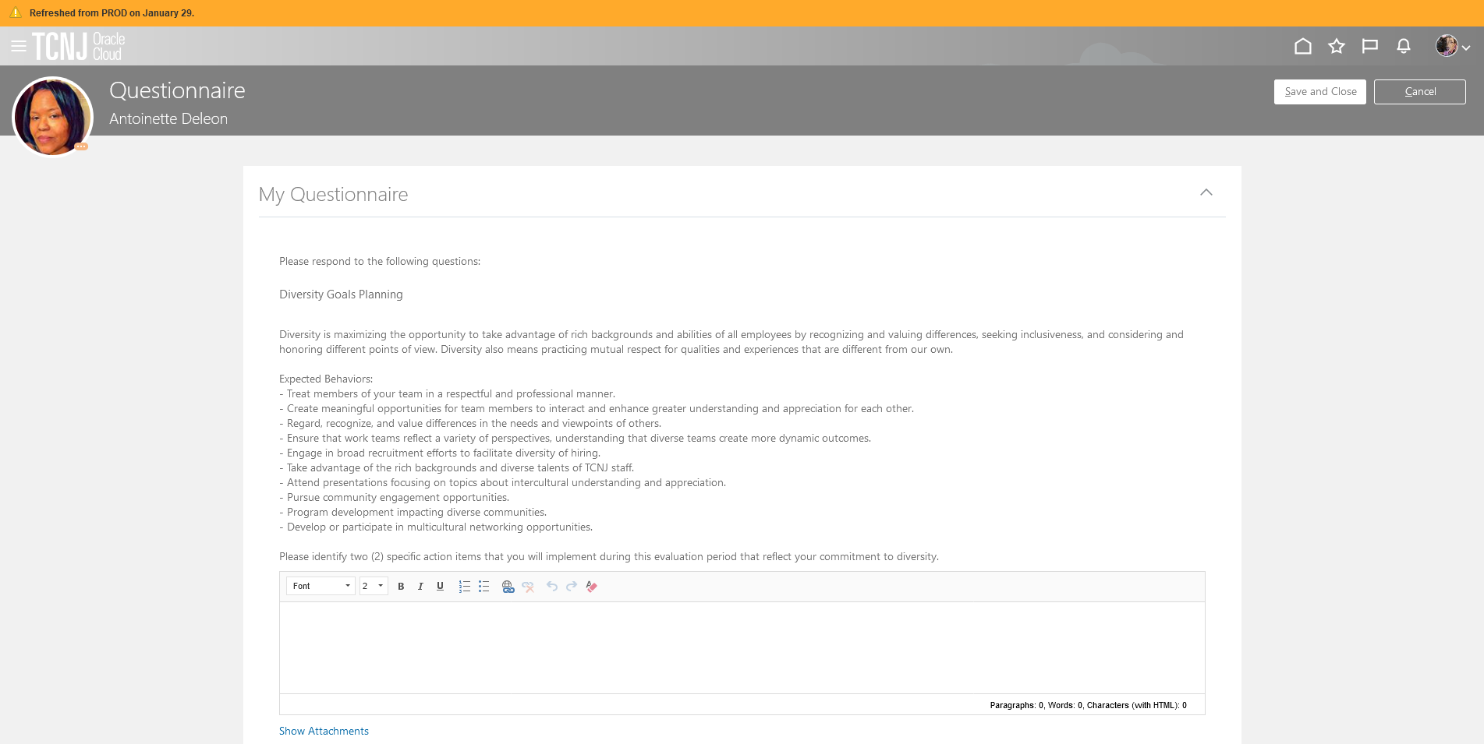
Enter diversity and performance goals for the FY24 performance cycle (two questions).
Enter diversity and performance outcomes for the 2022-2023 performance year (two questions).
Note that the employee’s survey is available for viewing at the bottom of the page. Press the down area to open it for viewing.
When you have completed your entries, click Save and Close.

Slide 22
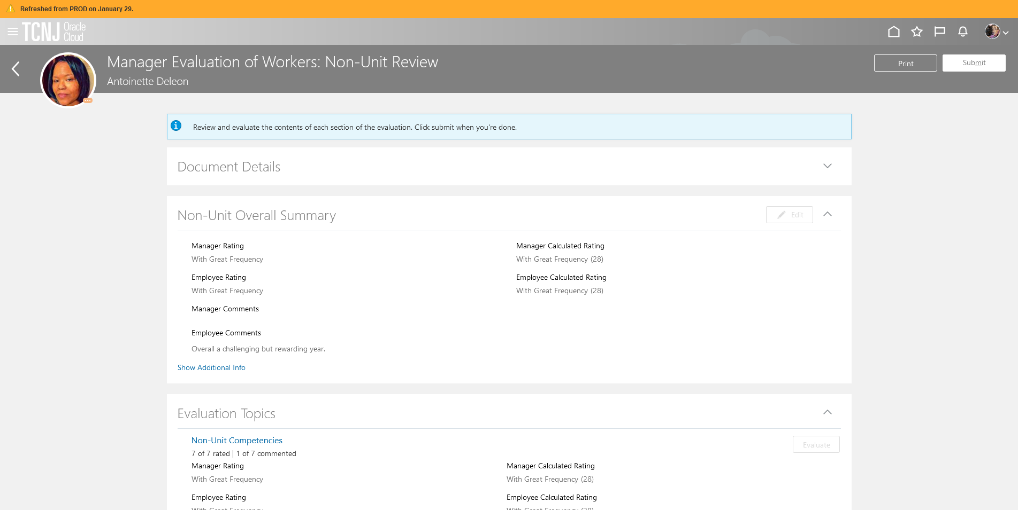
Click Edit to open the summary screen.

Slide 23
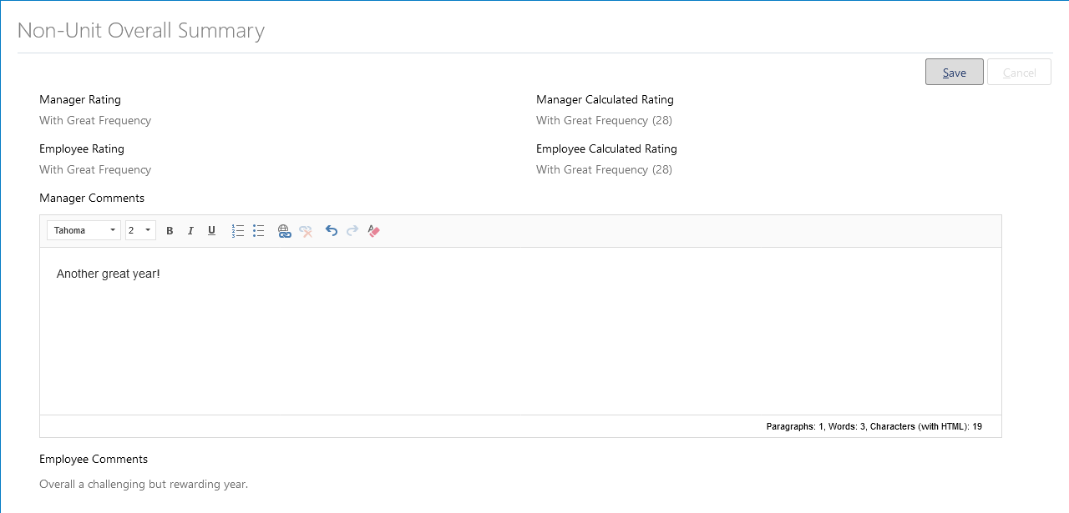
Enter comments to summarize the performance results for the year.
Click Save

Slide 24
Click Submit

Slide 25
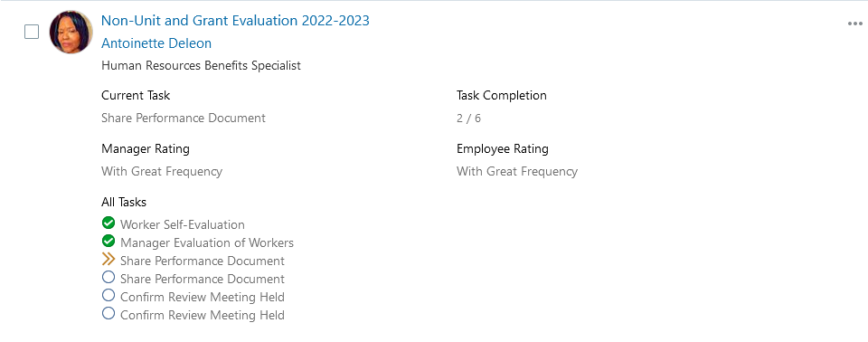
You are now taken out of the document. Notice how there is now an orange chevron next to the Share Performance Document task. Press the Non-Unit and Grant 2022-2023 link to return to the document.

Slide 26
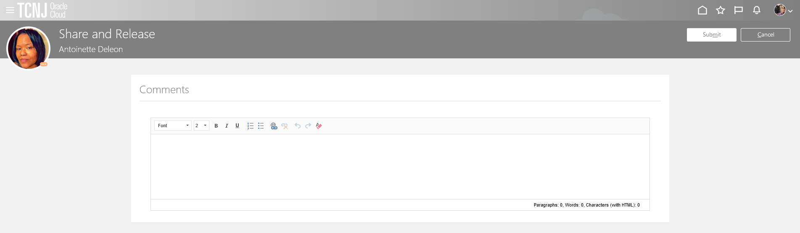
The manager should now share and release the document. When released, the document will be visible to the employee. Press the light Share and Release button.
The manager has the option to put additional comments in the box that appears after sharing the document. Whether or not comments are filled it, press Submit

Slide 27
The completed evaluation is now available for the employee to review. The employee now enters Oracle to view the document.
Confirm that the ME icon is underscored.
Click the Career and Performance title.

Slide 28
Click the Performance tile.

Slide 29
Click the Non-Unit and Grant Evaluation 2022-2023 link.

Slide 30
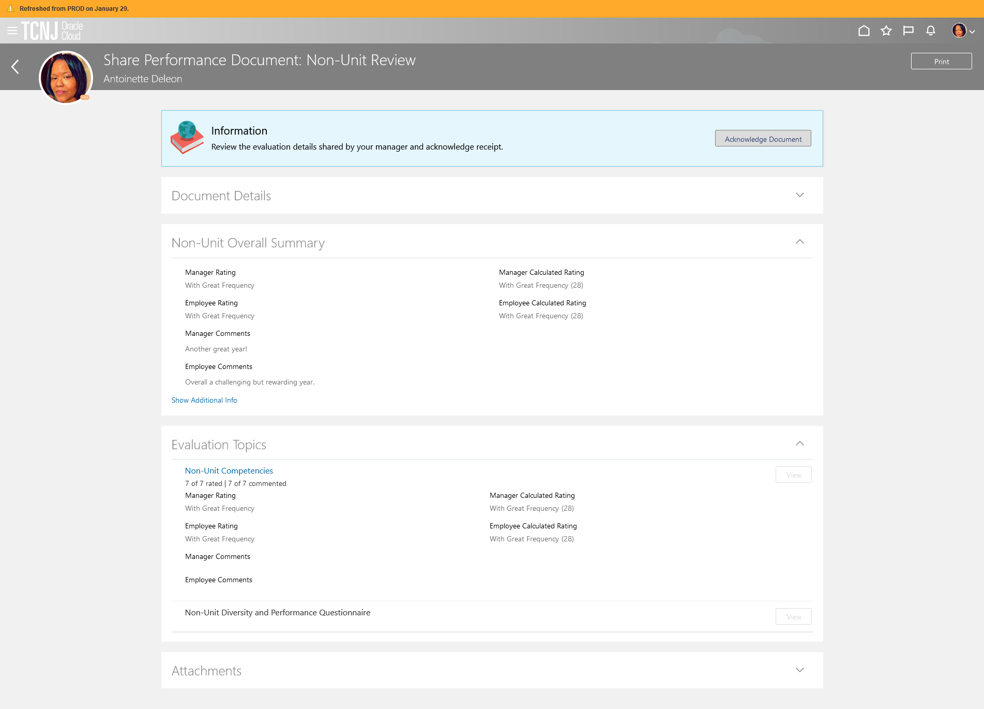
The employee is able to view the updated performance evaluation, including the overall summary, the competencies, and the questionnaire. When complete, press the Acknowledge Document button at the top.

Slide 31
The employee has the option to put additional comments in the box that appears after acknowledge the document. Whether or not comments are filled it, press Submit

Slide 32
The evaluation is now returned to the manager. The manager should schedule a review meeting with the employee to review the document. This is done outside of Oracle. Once the meeting is held, the manager will document the performance discussion taking place.
Log in with your username and password
Confirm that the My Team icon is underscored
Click the Performance title.

Slide 33
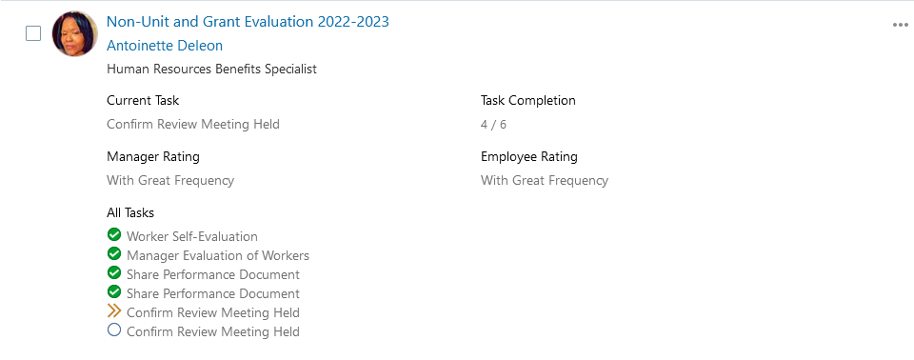
Confirm that Non-Unit and Grant 2022-2023 appears in the dropdown box. All employees in this cycle will appear. Workers ready for the manager to capture the performance discussion date will appear with an orange chevron next to the first Confirm Review Meeting Held task.

Slide 34
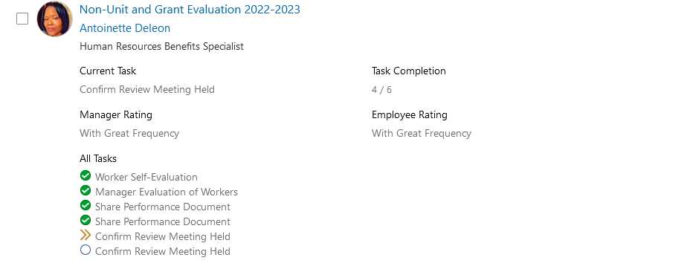
The manager clicks the Non-Unit and Grant 2022-2023 link.
The manager then clicks the Indicate Meeting Held link.

Slide 35
Manager enters the date the performance evaluation meeting occurred and then clicks the Submit button.

Slide 36
The employee now enters Oracle to confirm they attended the review meeting.
Confirm that the ME icon is underscored.
Click the Career and Performance title.

Slide 37
Click the Performance tile.

Slide 38
Employee clicks the Non-Unit and Grant 2022-2023 link.

Slide 39
Employee clicks Acknowledge Meeting. Once the meeting has taken place and is acknowledged by the employee, this performance evaluation is complete.
.

Slide 40
The employee’s evaluation is now complete. If the manager wants to view the document, they will need to perform additional navigation.
Log in with your username and password
Confirm that the My Team icon is underscored
Click the Performance title.

Slide 41
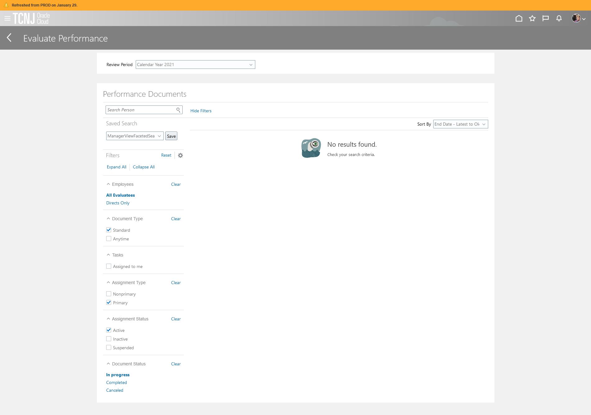
Navigate to the bottom Document Status area and click on Completed

Slide 42
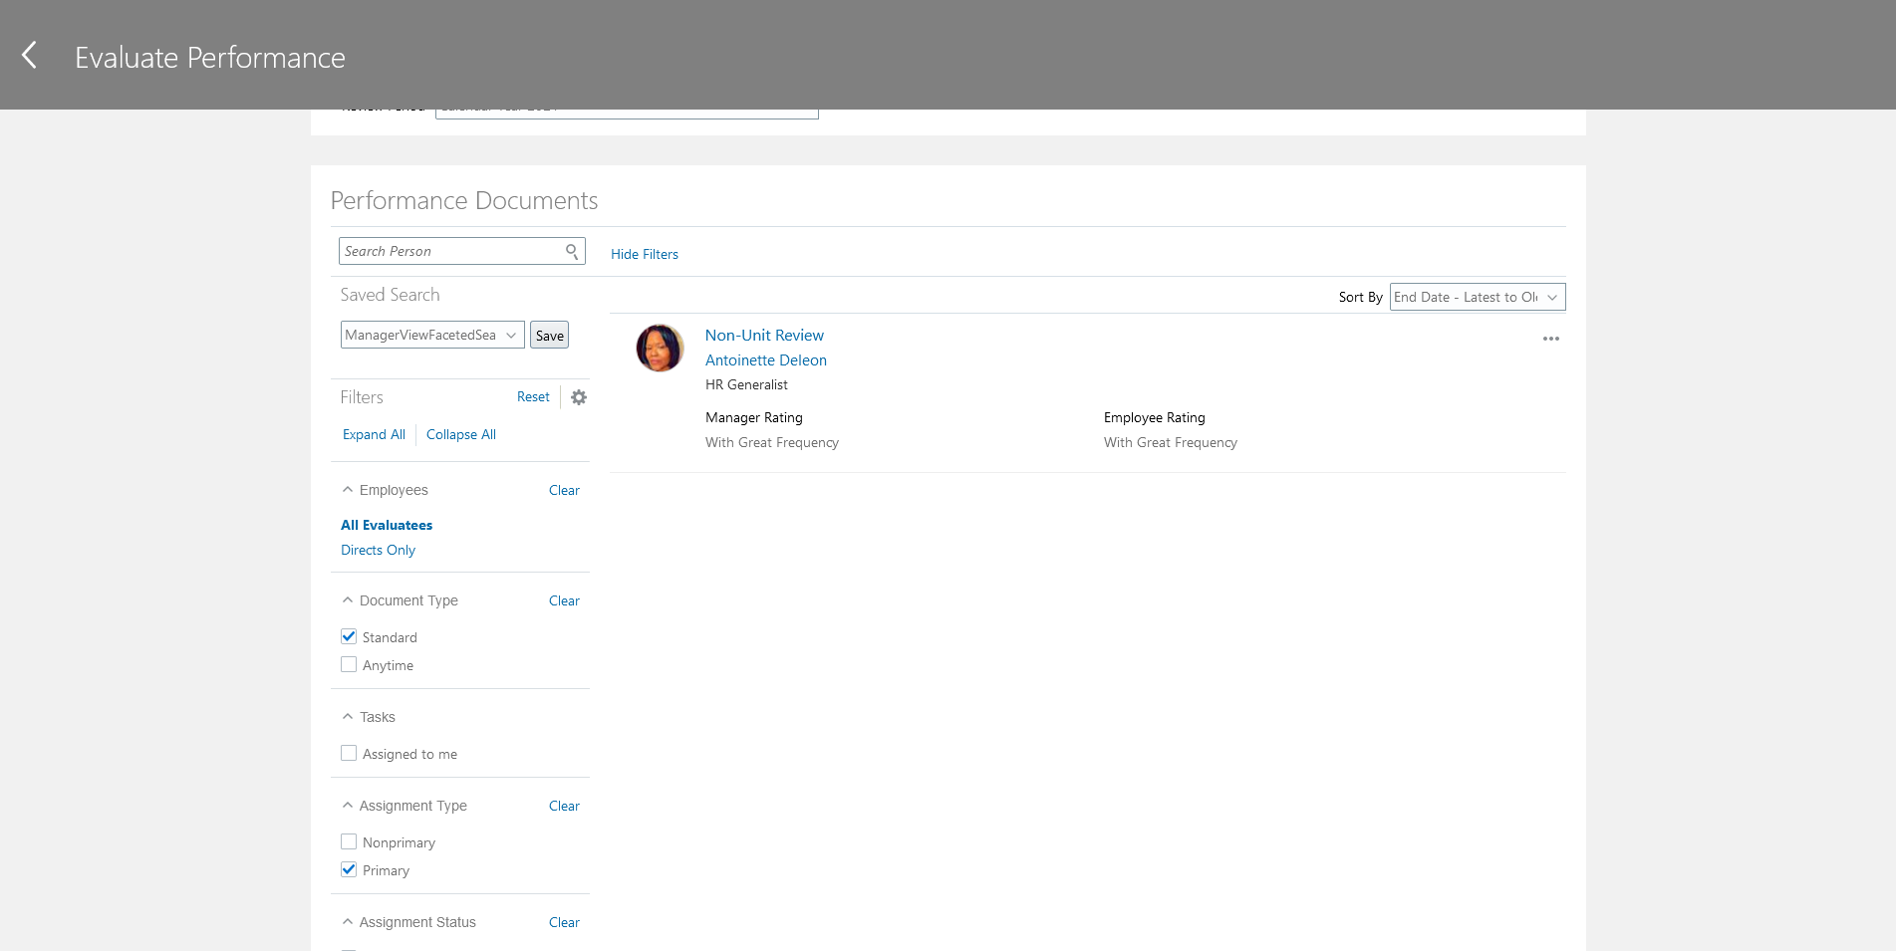
Now the review appears and can be viewed as it was when still in progress.

Slide 43
Questions?
If you have any questions related to the HCM Cloud processes associated with performance management, please contact Steve Gall at galls@tcnj.edu. For general inquiries regarding performance evaluations, timelines, or ratings, please contact Cristi Cartwright at cartwric@tcnj.edu.

